Slide 2
Building Teams, Scaling Operations, and Strengthening Affiliate Networks
JAMISHA BRELAND
AMAREN Transportation & Management
AARON MILLER
BASE Transportation Solutions
JEFF NYIKOS
Leros Transportation Group
Moderator: TIFFANY HINTON of MOTEV
Audio Visual
Sponsor
Coffee Sponsor

Slide 3
Welcome & Thank You to Our Sponsors
Coffee Sponsor
Audio Visual Sponsor

Slide 4
BEST PRACTICES FOR BUILDING YOUR TEAM
TPC: TALENT, PEOPLE, CULTURE
Hire the Right People
Professional, customer-focused chauffeurs
Communications
Vetting process
Audio Visual
Sponsor

Slide 5
BEST PRACTICES FOR BUILDING YOUR TEAM
TPC: TALENT, PEOPLE, CULTURE
Create a Strong Company Culture
Expectations
Team-oriented environment
Recognize and reward
Audio Visual
Sponsor

Slide 6
BEST PRACTICES FOR BUILDING YOUR TEAM
TPC: TALENT, PEOPLE, CULTURE
Lead by Example
Be hands-on and approachable
Stay adaptable
Professionalism and customer service daily
Audio Visual
Sponsor

Slide 7
OUTLINING AN AFFILIATE RELATIONSHIP
Communication
Expectations, rates, transfer of information, accessibility
Delivering on Agreed-to Service Level and Maintaining Integrity
What does this look like?
Continuing to Work Together Based on Previous Experiences
Trust, consistency, communication, transparency
Audio Visual
Sponsor

Slide 8
EXPANSION & SCALING
Individual Large Group Adaptation
Upsize/Downsize Fleet and Staffing Based on Needs
When Is the Right Time to Make a Change?
Audio Visual
Sponsor

Slide 9
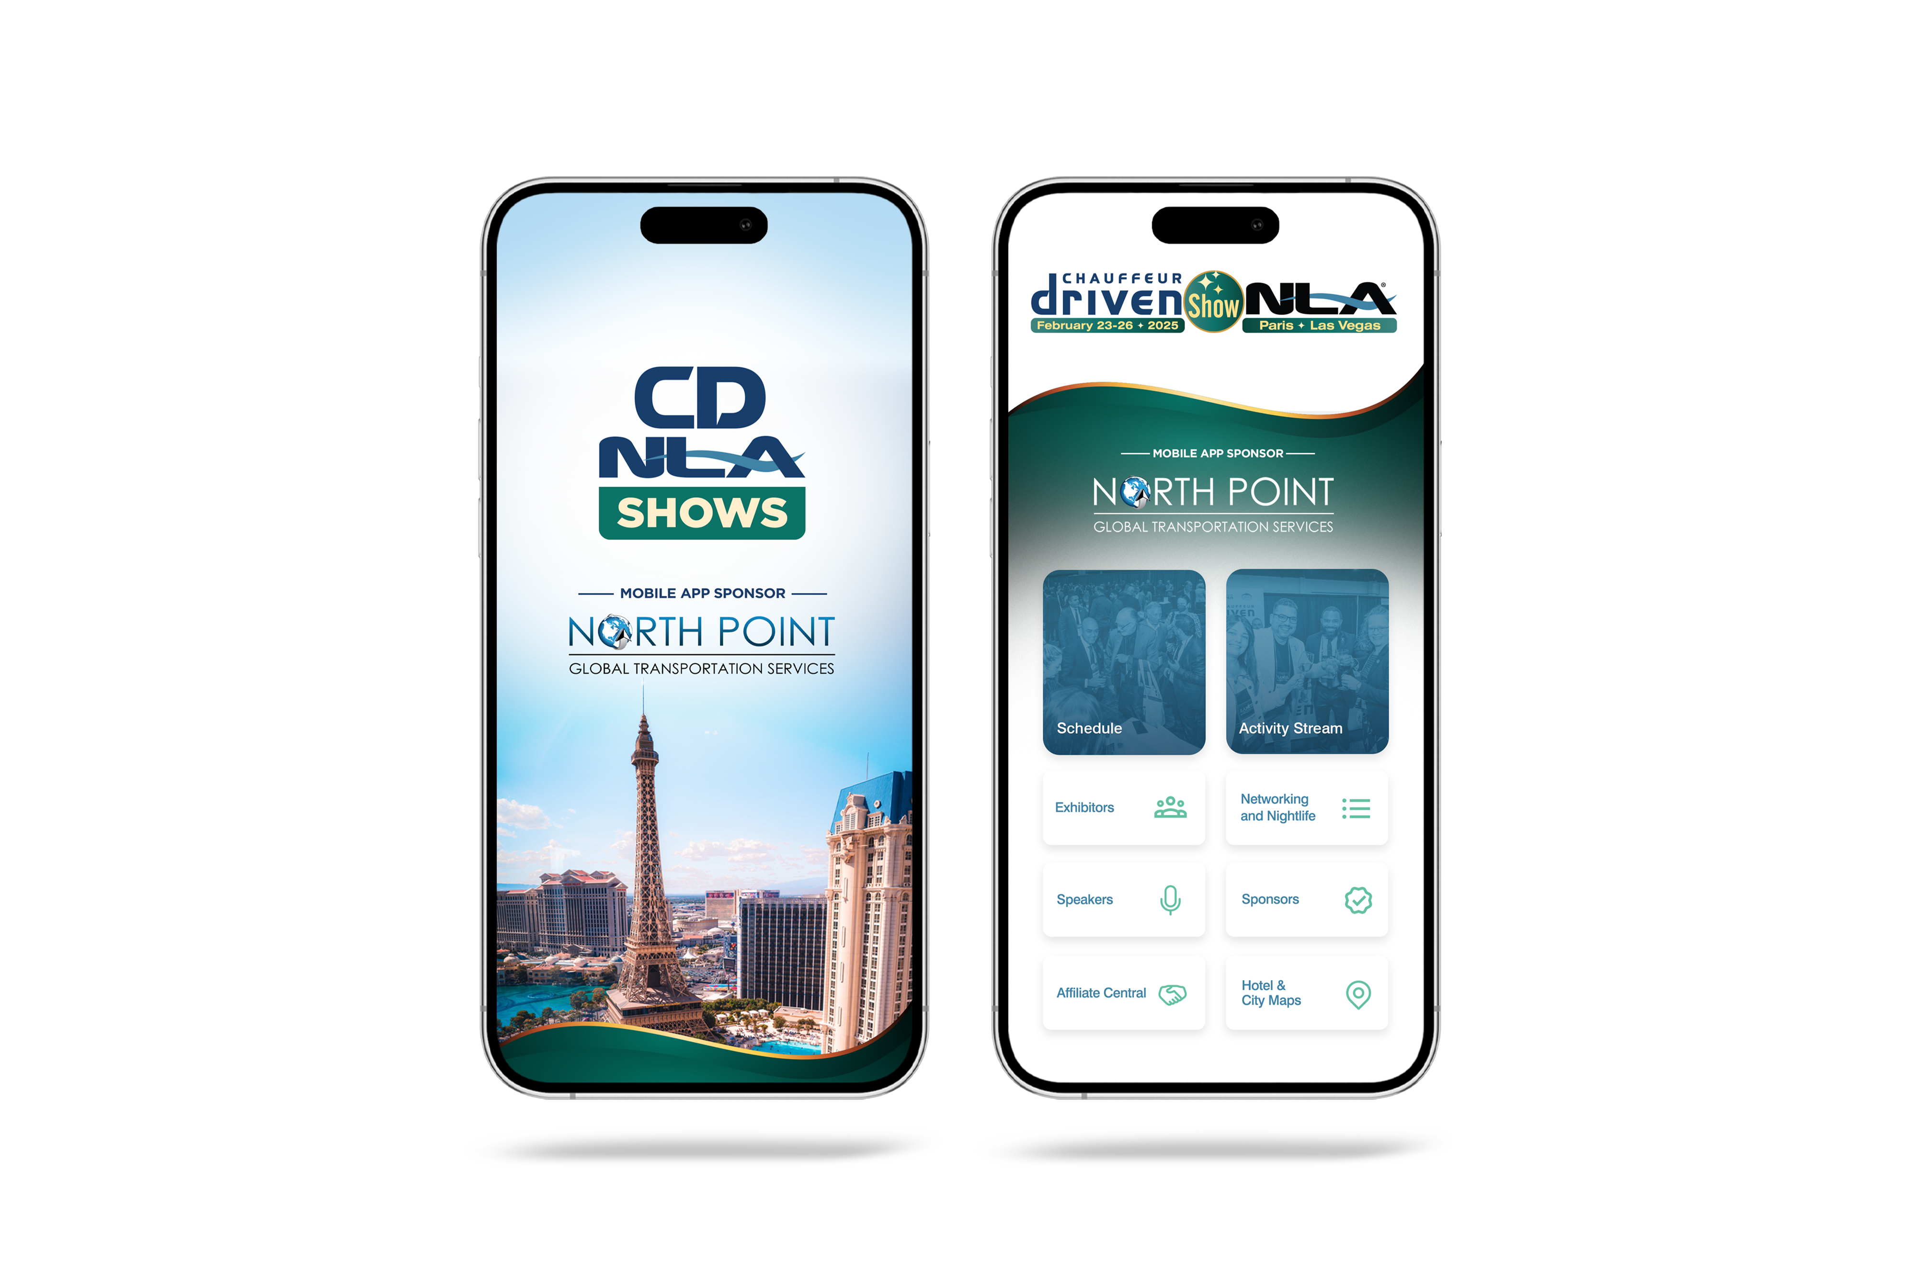
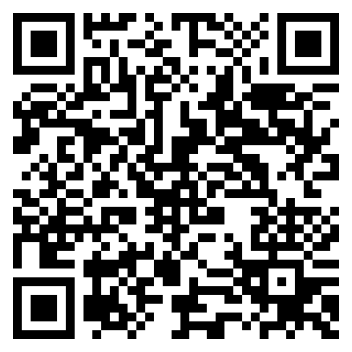
Let Us Know How
We Did!
Fill Out the Survey

Slide 10
Thank You for Joining Us!

